Slide 1






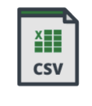

DATA FLOW
Bronze
Silver
Gold
Visualization

